Slide 1
Explorathon 2016
Exploring Computer Science
Through Game Development

Slide 2



Women in Computer Science

Slide 3
Careers in Computer Science
Software Engineer
Web Application Developer
Mobile Application Developer
Video Game Developer
...and so much more!
Today we will show you what its like to develop a video game and write real code!

Slide 4
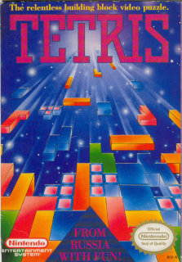
Our Inspiration
The game we will create today is based on the classic video game Tetris. We have changed the images, but the heart of Tetris remains.
We have also supplied a finished version of our game.

Slide 5
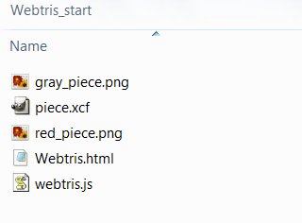
Open the starter project
Open up the file browser
Find the Webtris_start folder in the flash drive
The initial setup of the project comes with:
  Files for the game piece graphics
  An HTML file that draws our pieces, calls our code, and displays our game
  A JavaScript file that does all the work!

Slide 6
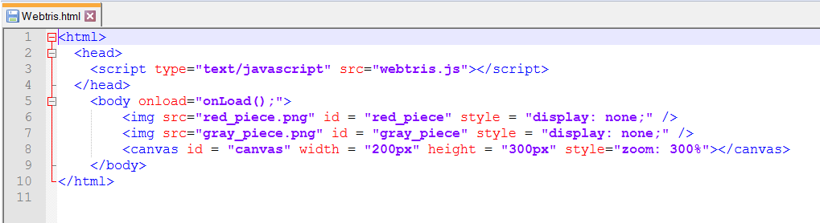
Our Simple HTML File
In the HTML file, the images are loaded in the body of the page, but they are hidden with “display:none”
The canvas element is what we draw our game on
A function named “onLoad()” is called on the body during the “onload” event.

Slide 7
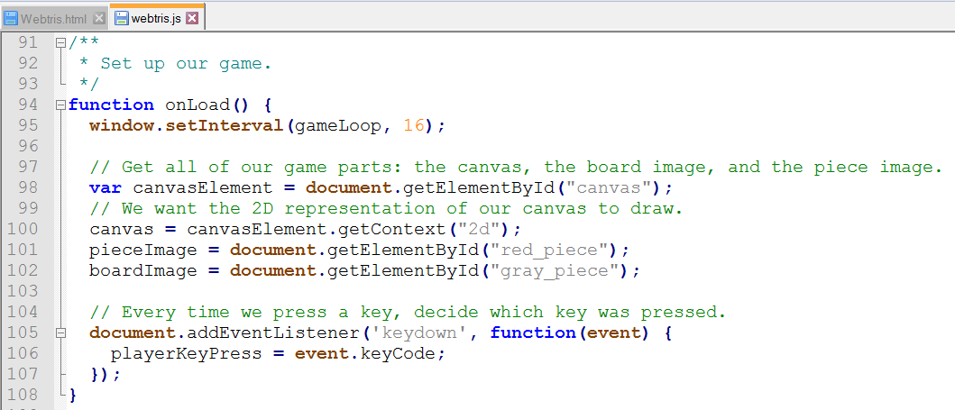
Our onLoad() Event
Open the
JavaScript file
If we scroll all the
way to the
bottom, we can
see our onLoad()
function
The onLoad() function first initializes our game loop
Then, it takes the canvas from the HTML file, and gets ready for us to draw with it
The code listens for key presses, and records the unique code
The gameLoop() function calls methods to handle input and draw the game

Slide 8
Let's Draw Something
Find the function at the top of the file called drawGame()
The first thing we are going to do is make a black background for our game
We will draw a black rectangle starting at (0, 0) with size 200px by 300px to fill the canvas
After we have written the code below in drawGame(), open the HTML file in the browser, you will see a black box.
function drawGame() {
canvas.fillStyle = "black";
canvas.fillRect(0, 0, 200, 300);
}

Slide 9
How to Draw an Image
Underneath our black background code, we're going to draw the piece image (a red square)
Again, we want to draw this at the top left corner at (0, 0)
After we write this one line of code, we can refresh our HTML file in the browser
canvas.drawImage(pieceImage, 0, 0);

Slide 10
Drawing a Piece
The next step is to change the line we just wrote to draw a whole Webtris piece instead of just one square
We used an “array” to define the shape of our game piece (see piece variable in webtris.js)
It looks a lot like a mathematical matrix!

Slide 11
Arrays – a Quick Lesson
Our JavaScript file is filled with arrays because they're easy to use to store our game board and the piece shapes
When we want to step through our array, we use something called a “for loop”
We grab the first row, and the first column
Our next step is the next column on the same row, until we run out of columns
Then we move to the next row
var piece =
[[0, 1, 0],
[0, 1, 0],
[0, 1, 1]];
Column
Row

Slide 12
Writing Our For Loop
for (var x = 0; x < piece[0].length; x ++) {
for (var y = 0; y < piece.length; y ++) {
if (piece[y][x] == 1) {
canvas.drawImage(pieceImage, x * 8, y * 8);
}
}
}
There are two “for loops” because we need to keep track of the row (x) and column (y)
When we find a 1 in our piece array, we can draw our single square
We multiply it by 8 because each square that makes up our piece is 8 pixels tall by 8 pixels wide
After we have our code written, let's check it in the browser!

Slide 13
Time to Move Our Pieces
In Tetris, we can move our pieces left and right, and even push it down
The next step is to listen to the key presses, and change our piece position based on that
Before we write our code, we need to review Cartesian coordinates

Slide 14
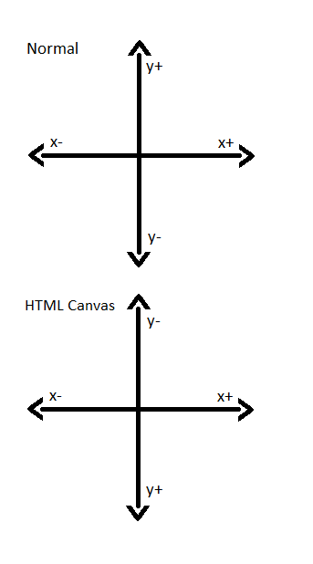
Coordinates - Quick Review
We can move our piece around on the screen according to x and y positions
When we want our piece to go left, our playerXIndex variable decreases
Because positive y is downward, when we press down we want to increase our playerYIndex
We don't want our pieces to move up, so we won't write any code for that direction

Slide 15
Make Things Move
Go to the handleInput() function above the drawGame() function
We are going to determine which key is pressed, then
change our piece direction based on that
Our unique codes for the key presses are already saved for us
  KEY_PRESS_DOWN
  KEY_PRESS_RIGHT
  KEY_PRESS_LEFT
We will start with KEY_PRESS_DOWN first
In order to see where our piece is, we need to update drawGame()
if (playerKeyPress == KEY_PRESS_DOWN) {
playerYIndex = playerYIndex + 1;
}

Slide 16
Updating drawGame()
Back on the drawGame() function, we need to change the line that draws our image
Add our updated position to the x and y coordinates
We need to multiply the entire x/y position by 8 because of the size of our square
After we've updated to the code below, it's time to test!
canvas.drawImage(pieceImage,
(x + playerXIndex) * 8,
(y + playerYIndex) * 8);

Slide 17
Other Directions
We can copy our “if statement” from earlier
If the user presses the right key, our playerXIndex is going to increase
If the player presses the left key, our playerXIndex is going to decrease
After we have the code below, we can test it in our browser
if (playerKeyPress == KEY_PRESS_DOWN) {
playerYIndex = playerYIndex + 1;
}
if (playerKeyPress == KEY_PRESS_RIGHT) {
playerXIndex = playerXIndex + 1;
}
if (playerKeyPress == KEY_PRESS_LEFT) {
playerXIndex = playerXIndex - 1;
}

Slide 18
Drawing Our Walls
Go back to our drawGame() function to draw our board
We do this by moving through our “board” matrix and drawing a boardImage where we find a 2
Refresh the browser to see our wall!
for (var x = 0; x < board[0].length; x ++) {
for (var y = 0; y < board.length; y ++) {
if (board[y][x] == 2) {
canvas.drawImage(boardImage, x * 8, y * 8);
}
}
}

Slide 19
Inside the Wall
Our piece is going through the walls!
To fix that, we have to write a new function to check for a “collision” to see if our wall is there
This function checks the player piece position against the position of the walls in our board variable
function checkCollision(playerXPosition, playerYPosition, playerRotation) {
for (var x = 0; x < piece[0].length; x ++) {
for (var y = 0; y < piece.length; y ++) {
var value = piece[y][x];
if (value > 0 && board[playerYPosition + y][playerXPosition + x] > 0) {
return true;
}
}
}
return false;
}

Slide 20
Handle Collision
We need to check for a collision inside of our handleInput() function using our new checkCollision() function
We tell checkCollision() to test the possible position (i.e. playerYIndex + 1)
If there is not a collision, then we can update our playerXIndex or playerYIndex
if (playerKeyPress == KEY_PRESS_DOWN) {
if (!checkCollision(playerXIndex, playerYIndex + 1)) {
playerYIndex = playerYIndex + 1;
}
}
if (playerKeyPress == KEY_PRESS_RIGHT) {
if (!checkCollision(playerXIndex + 1, playerYIndex)) {
playerXIndex = playerXIndex + 1;
}
}
if (playerKeyPress == KEY_PRESS_LEFT) {
if (!checkCollision(playerXIndex - 1, playerYIndex)) {
playerXIndex = playerXIndex - 1;
}
}

Slide 21
Steps to Finish Your Game
Create the other piece shapes
Make the pieces appear randomly
Each time a line is formed, destroy it! After 10 lines have been removed, speed up the game
Display each piece with a count of how many were generated
Create a score board and keep track of the score
Make the pieces fall smoothly
Please keep an eye on https://github.com/originalgrego/Webtris for additions to this tutorial

Slide 22
Thank you!
Included on your flash drive are the following programs
  Notepad++ – a text editor with syntax highlighting, good for writing code
  Game Maker – A free to evaluate game engine (plus last year's slides!)
  Gimp – A free and open source image editor
  Audacity – A free sound editing program
  Reaper – A digital audio workstation program providing convenient licensing
  Blender – A free and open source 3d modeling tool
  Tiled – A free and open source Tile Map editing tool, used for creating complex levels
Please visit https://github.com/originalgrego/Webtris for future updates to this project or to help in its development. Webtris is a GPL'd open source project that anyone can contribute to!
We hope you enjoyed Webtris!

